Slide 1
Schema Design: Stars, Snowflakes, and Fact Constellations: Schemas for Multidimensional Databases The entity relationship data model is commonly used in the design of relational databases, where a database schema consists of a set of entities and the relationships between them. Such a data model is appropriate for online transaction processing. A data warehouse, however, requires a concise, subject-oriented schema that facilitates on-line data analysis. The most popular data model for a data warehouse is a multidimensional model. Such a model can exist in the form of a star schema, a snowflake schema, or a fact constellation schema. Let’s look at each of these schema types. Star schema: The most common modeling paradigm is the star schema, in which the data warehouse contains (1) a large central table (fact table) containing the bulk of the data, with no redundancy, and (2) a set of smaller attendant tables (dimension tables), one for each dimension. The schema graph resembles a starburst, with the dimension tables displayed in a radial pattern around the central fact table.
Star schema: A star schema for All Electronics sales is shown in Figure. Sales are considered along four dimensions, name, time, item, branch, and location. The schema contains a central fact table for sales that contains keys to each of the four dimensions, along with two measures: dollars sold and units sold. To minimize the size of the fact table, dimension identifiers (such as time key and item key) are system-generated identifiers. Notice that in the star schema, each dimension is represented by only one table, and each table contains a set of attributes. For example, the location dimension table contains the attribute set {location key, street, city, province or state, country}. This constraint may introduce some redundancy.

Slide 2
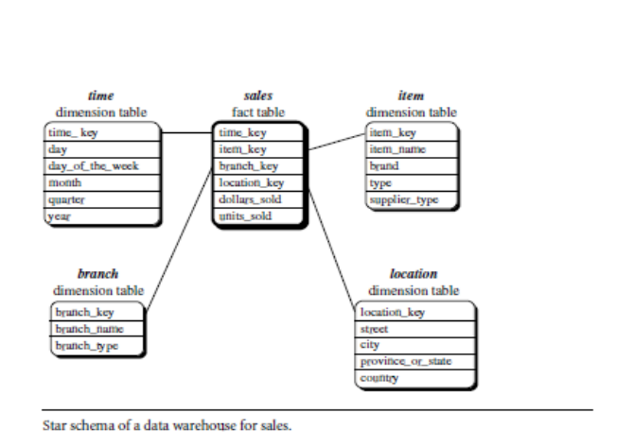

Slide 3
Snowflake schema.: A snowflake schema for AllElectronics sales is given in Figure Here, the sales fact table is identical to that of the star schema in Figure . The main difference between the two schemas is in the definition of dimension tables. The single dimension table for item in the star schema is normalized in the snowflake schema, resulting in new item and supplier tables. For example, the item dimension table now contains the attributes item key, item name, brand, type, and supplier key, where supplier key is linked to the supplier dimension table, containing supplier key and supplier type information. Similarly, the single dimension table for location in the star schema can be normalized into two new tables: location and city. The city key in the new location table links to the city dimension. Notice that further normalization can be performed on province or state and country in the snowflake schema

Slide 4
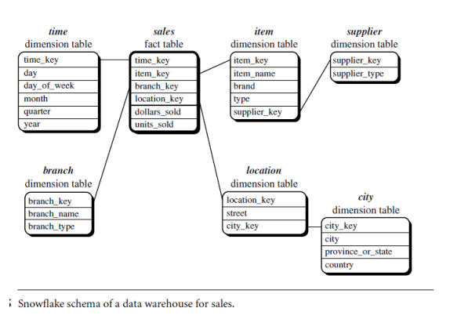

Slide 5
Fact constellation.
A fact constellation schema is shown in Figure. This schema specifies two fact tables, sales and shipping. The sales table definition is identical to that of the star schema . The shipping table has five dimensions, or keys: item key, time key, shipper key, from location, and to location, and two measures: dollars cost and units shipped. A fact constellation schema allows dimension tables to be shared between fact tables. For example, the dimensions tables for time, item, and location are shared between both the sales and shipping fact tables. In data warehousing, there is a distinction between a data warehouse and a data mart.
A data warehouse collects information about subjects that span the entire organization, such as customers, items, sales, assets, and personnel, and thus its scope is enterprise-wide. For data warehouses, the fact constellation schema is commonly used, since it can model multiple, interrelated subjects. A data mart, on the other hand, is a department subset of the data warehouse that focuses on selected subjects, and thus its scope is department wide. For data marts, the star or snowflake schema are commonly used, since both are geared toward modeling single subjects, although the star schema is more popular and efficient.

Slide 6
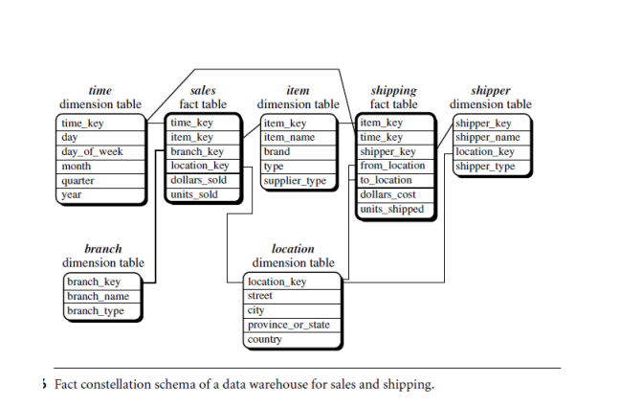

Slide 7
Data Warehouse Design Process:
A data warehouse can be built using a top-down approach, a bottom-up approach, or a combination of both.
The top-down approach starts with the overall design and planning. It is useful in cases where the technology is mature and well known, and where the business problems that must be solved are clear and well understood.
The bottom-up approach starts with experiments and prototypes. This is useful in the early stage of business modeling and technology development. It allows an organization to move forward at considerably less expense and to evaluate the benefits of the technology before making significant commitments.
In the combined approach, an organization can exploit the planned and strategic nature of the top-down approach while retaining the rapid implementation and opportunistic application of the bottom-up approach .

Slide 8
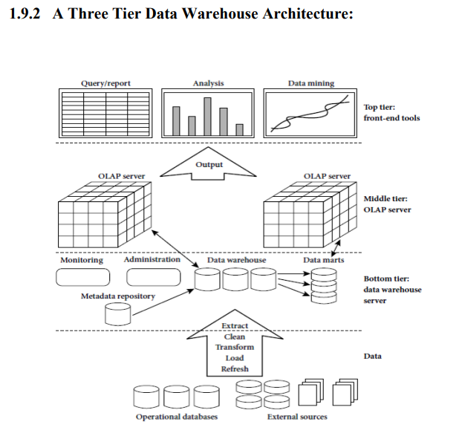

Slide 9
Tier-1:
The bottom tier is a warehouse database server that is almost always a relationaldatabase system. Back-end tools and utilities are used to feed data into the bottomtier from operational databases or other external sources (such as customer profileinformation provided by external consultants). These tools and utilities performdataextraction, cleaning, and transformation (e.g., to merge similar data from differentsources into a unified format), as well as load and refresh functions to update thedata warehouse . The data are by the underlying DBMS andallows client programs to generate extracted using application programinterfaces known as gateways. A gateway is supported SQL code to be executed at a server. Examples
of gateways include ODBC (Open Database Connection) and OLEDB (Open Linkingand Embedding for Databases) by Microsoft and JDBC (Java Database Connection). This tier also contains a metadata repository, which stores information aboutthe data warehouse and its contents.

Slide 10
Tier-2:
The middle tier is an OLAP server that is typically implemented using either a relational OLAP (ROLAP) model or a multidimensional OLAP. OLAP model is an extended relational DBMS thatmaps operations on multidimensional data to standard relational operations. A multidimensional OLAP (MOLAP) model, that is, a special-purpose server that directly implements multidimensional data and operations.
Tier-3:
The top tier is a front-end client layer, which contains query and reporting tools, analysis tools, and/or data mining tools (e.g., trend analysis, prediction, and so on).

